Slide 1
The USA: Devided or United?
Chapter 6.3: Free from the Motherland

Slide 2
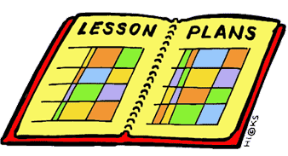
Lesson Plan
Welcome Magister
Lesson plan
The Question of today
American War of Independance
The reasons
The result
Recap (notes)
Homework
Ending
Introduction
Lesson plan
The Question
The Reasons
The Result
Recap (notes)
Homework
Ending

Slide 3
Lesson Goals
Introduction
Lesson plan
The Question
The Reasons
The Result
Recap (notes)
Homework
Ending
The question of today is:
How did thirteen British colonies change into thirteen American States?

Slide 4
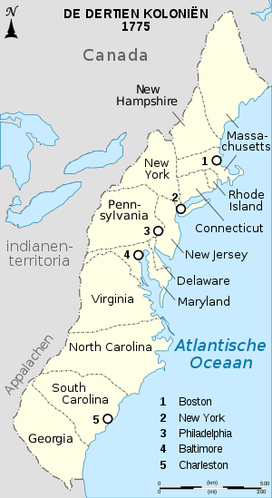
Prologue to the American Revolution
The French Indian War (1754 – 1763) – page 134
French and Indians against the British colonists;
The war was a military succes for the British;
Increased self-awareness;
Result of the war?
French defeated
Empty British treasure chest!
Introduction
Lesson plan
The Question
The Reasons
The Result
Recap (Notes)
Homework
Ending

Slide 5
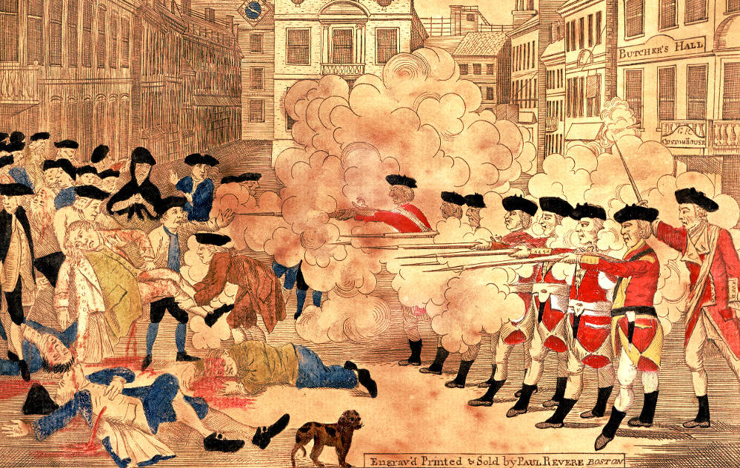
The American Revolution
After the French Indian War
Increase in taxes;
More and more riots No Taxation without representation!
Introduction
Lesson plan
The Question
The Reasons
The Result
Recap (Notes)
Homework
Ending

Slide 6
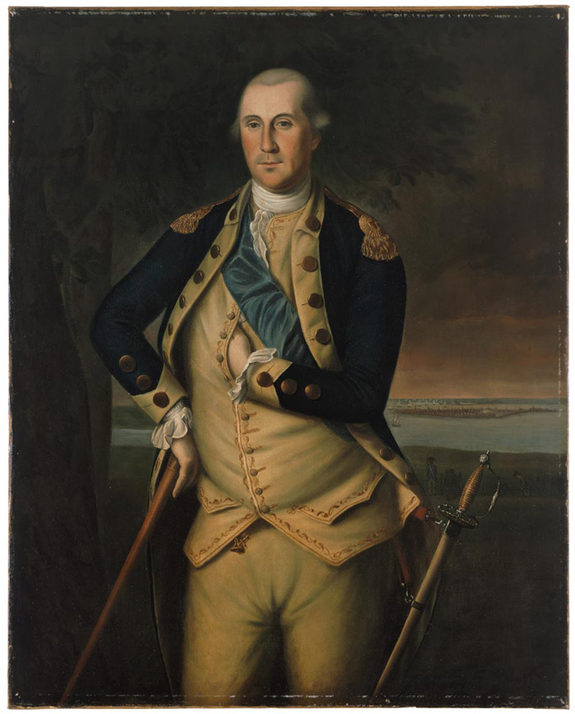
The American Revolution
1773:
After the Boston Tea Party the English king was furious and shut down the self-government and Jurisdiction;
The colony’s response was: “No more Taxation without Representation”
1775:
32.000 British soldiers send to the colonies in order
to get control back;
George Washington is appointed commander in chief;
Introduction
Lesson plan
The Question
The Reasons
The Result
Recap (Notes)
Homework
Ending

Slide 7
The Result
4 july 1776: The Declaration of Independance
In 1783: The settlers defeat England supported by France and Spain
Introduction
Lesson plan
The Question
The reason
The Result
Recap (Notes)
Homework
Ending

Slide 8
The Result – Trias Politica
The United States of America
Introduction
Lesson plan
The Question
The reason
The Result
Recap (Notes)
Homework
Ending

Slide 9
Recap (Notes)
How did thirteen British colonies change into thirteen American States?
Increased self awareness thanks to the seven years war against French and Indians;
Empty English treasure chest;
Increase of taxes by the English King;
Increase in Riots, Boston Massacre in 1770;
Boston Tea party in 1773;
Increase of troops in 1775 by the English to 32.000;
4th of July 1776: Declaration of Independance;
In 1783 British defeated by combined forces of settlers, French and Spanish troops;
In 1789 The American constitution was adopted;
Introduction
Lesson plan
The Question
The reason
The Result
Recap (Notes)
Homework
Ending

Slide 10
Homework
Assignment:
Make your own country (worksheet)
Homework:
Learn 6.3
make questions 1 until 6
Introduction
Lesson plan
The Question
The reason
The Result
Recap (Notes)
Homework
Ending

Slide 11
Ending
What Sticks?
Next week: The Expansion of the USA

